Slide 1
A Hybrid IP Lookup Architecture with Fast Updates
Author: Layong Luo, Gaogang Xie, Yingke Xie,
Laurent Mathy, Kavé Salamatian
Publisher: 2012 IEEE INFOCOM
Presenter: Yen-Chun Tseng
Date: 2015/9/30
Department of Computer Science and Information Engineering
National Cheng Kung University, Taiwan R.O.C.
Notes:
1

Slide 2
Outline
Introduction
Proposed scheme
Performance Evaluation

Slide 3
Introduction
The architecture is based on an efficient trie partitioning scheme.
The trie divides the Forwarding Information Base (FIB) into two prefix sets:
  A large disjoint leaf prefix set mapped into an external TCAM-based lookup engine
  A small overlapping prefix set mapped into an on-chip SRAM-based lookup pipeline.
Notes:
When packet matches expression, may do less work than Thompson's
algorithm

Slide 4
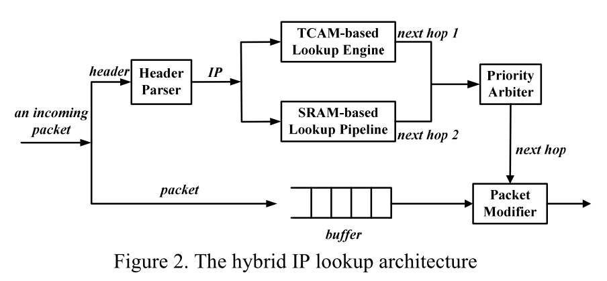
Introduction
Notes:
When packet matches expression, may do less work than Thompson's
algorithm

Slide 5
Outline
Introduction
Proposed scheme
Performance Evaluation

Slide 6
Proposed scheme
About 90% of all prefixes are stored in trie leaves and are thus disjoint from each other.
When the leaf nodes are removed from the original trie, non-prefix internal nodes that only lead to those leaf nodes can also be removed, and we are left with a much smaller trimmed trie, which contains, on average, only about 12% of the nodes of the original trie.

Slide 7
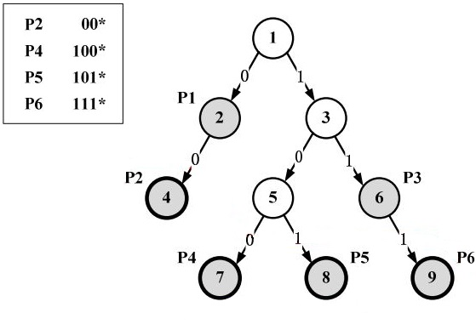
Proposed scheme

Slide 8
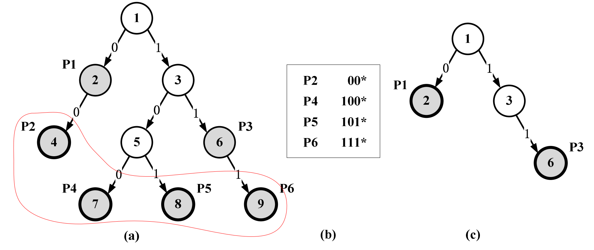
Proposed scheme

Slide 9
Proposed scheme

Slide 10
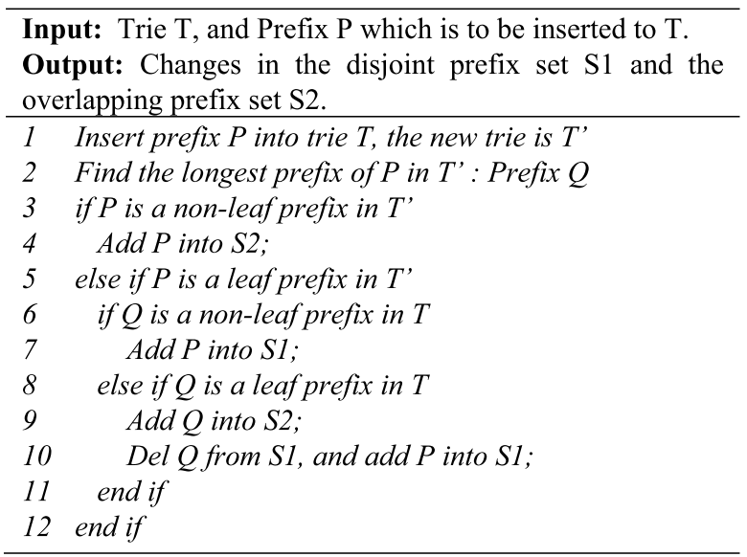
Proposed scheme

Slide 11
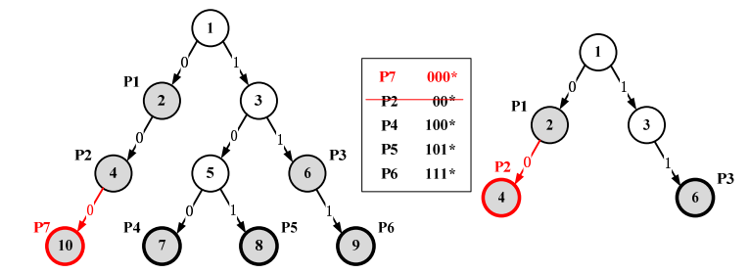
Proposed scheme
(1) prefix P2 should be inserted into the overlapping trie.
(2) prefix P2 should be deleted from the disjoint prefix set.
(3) prefix P7 should be inserted into the disjoint prefix set.

Slide 12
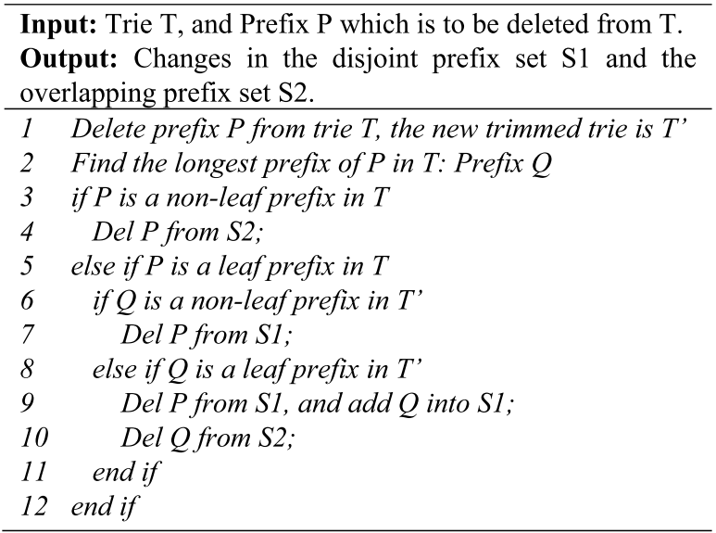
Proposed scheme

Slide 13
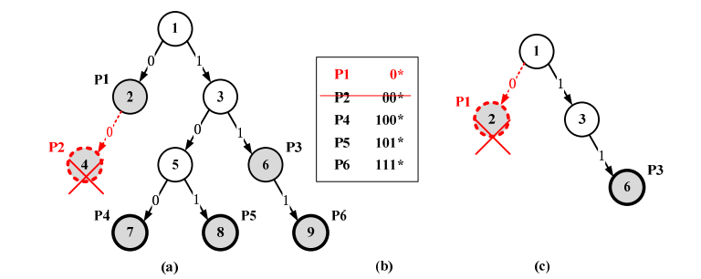
Proposed scheme
(1) prefix P2 should be deleted from the disjoint prefix set.
(2) prefix P1 should be inserted into the disjoint prefix set.
(3) prefix P1 should be deleted from the overlapping trie.

Slide 14
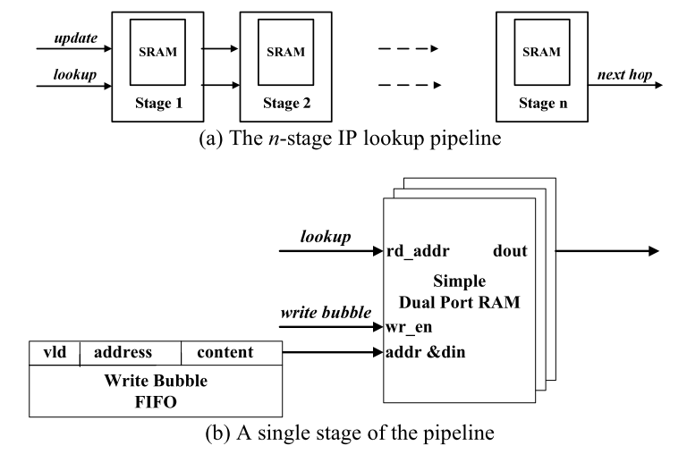
Proposed scheme

Slide 15
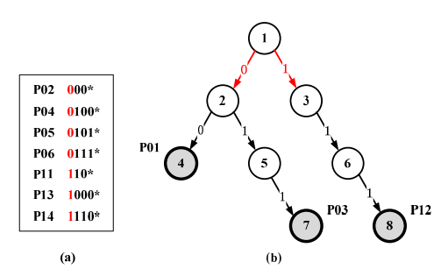
Proposed scheme

Slide 16
Outline
Introduction
Proposed scheme
Performance Evaluation

Slide 17
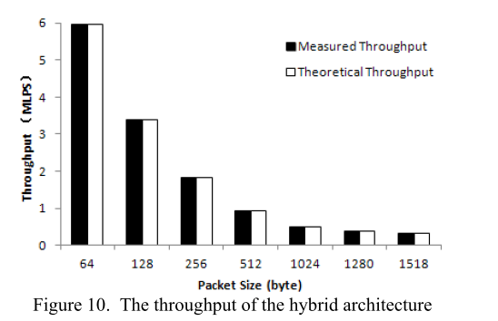
Performance Evaluation

Slide 18
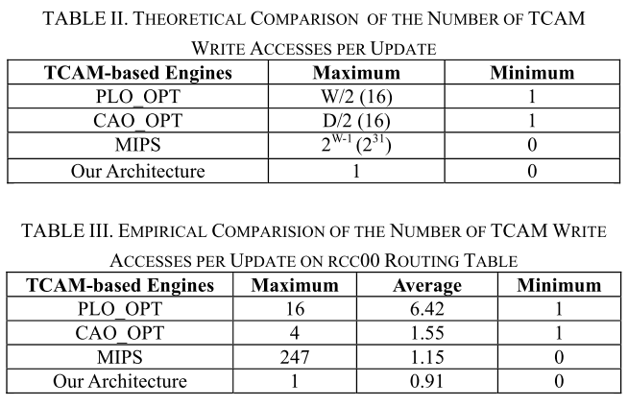
Performance Evaluation

Slide 19
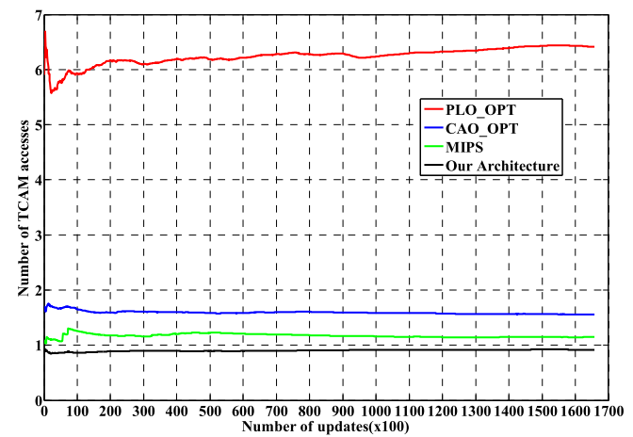
Performance Evaluation

